Slide 1
人工智慧及其應用
萬能科技大學資訊工程系暨電資研究所
江義淵 助理教授

Slide 2
Outline
Introduction
Moocs
My research
Deep Learning
Convolution Neural Network
Autoencoder
Transfer Learning
Transfer Learning for WiFi-based indoor localization
Text while driving
Summary

Slide 3
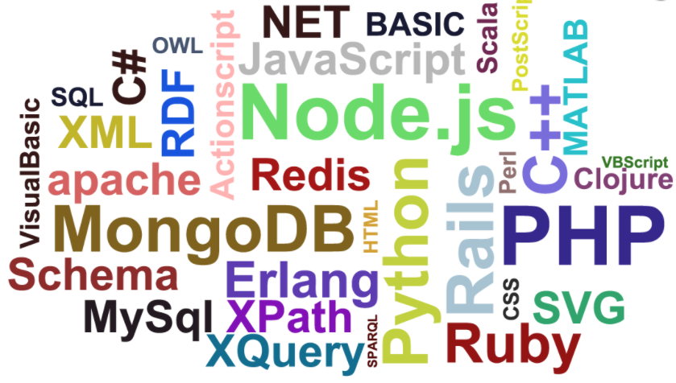
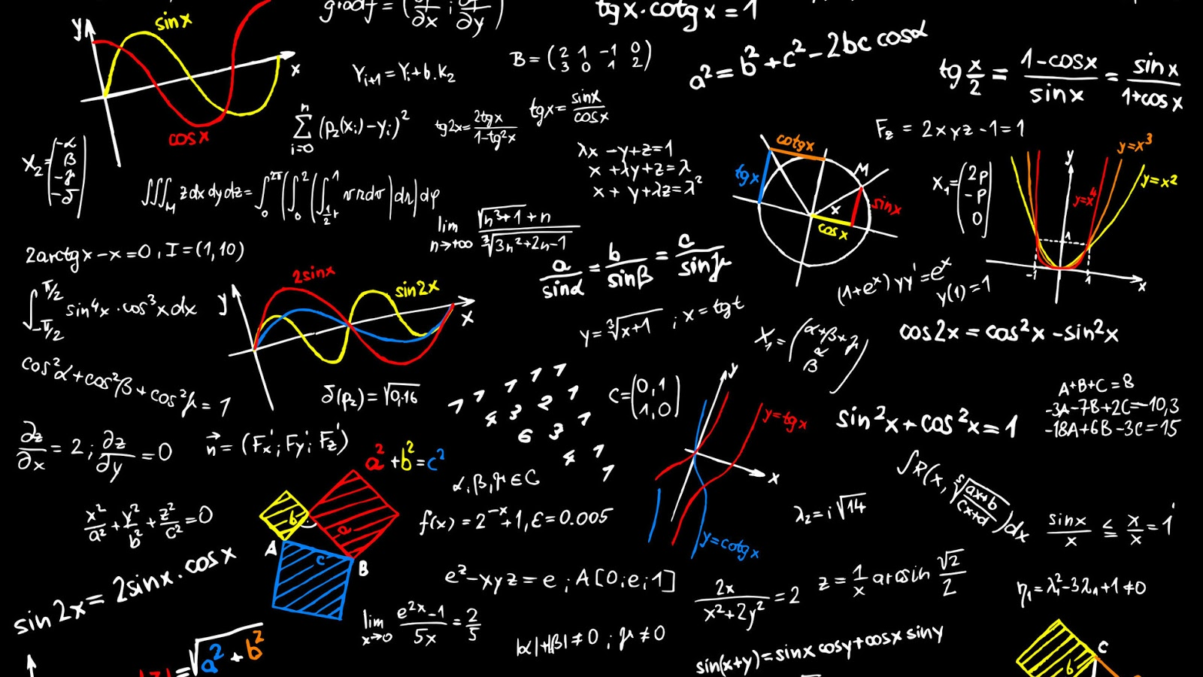

My background

Slide 4

我想做的事

Slide 5

Uber與Airbnb憑什麼翻轉世界

Slide 6

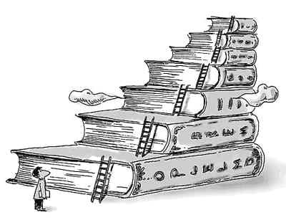
我常在做的事

Slide 7

現在的工作

Slide 8
Artificial Intelligence (AI)
是指由人製造出來的機器所表現出來的智慧 (wiki)
Sensor
眼
鼻
觸覺
…
人
Decision maker
Action

Slide 9
Inference system (1/2)
x₁
Knowledge representation
x₂
y
…
Inference engine
x_{n}

Slide 10
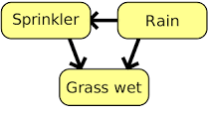
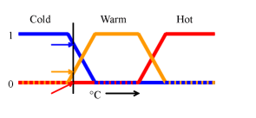
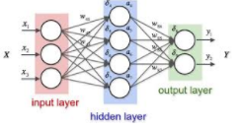
Inference system (2/2)
貝氏網路(Bayesian network)
模糊邏輯(Fuzzy logic)
類神經網路(Neural network)
…

Slide 11
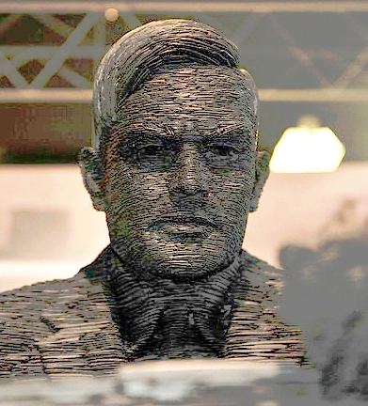
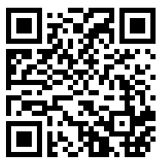
AI 之父
罗辑思维 138 庸众的迫害
https://www.youtube.com/watch?v=8geixxRrdGQ&t=189s
得到App (每天聽本書-盜火)

Slide 12
MOOC三大平台
Coursera 、Edx、Udacity
同儕互評機制
討論區機制
課程認證機制
「簽名認證(signature track)」課程指的是利用具照片的身分證明和特殊的打字模型來證明學生身分。
學生每次交作業都需要透過webcam拍攝相片和以實體鍵盤打字進行比對認證，確定是同一個人。

Slide 13
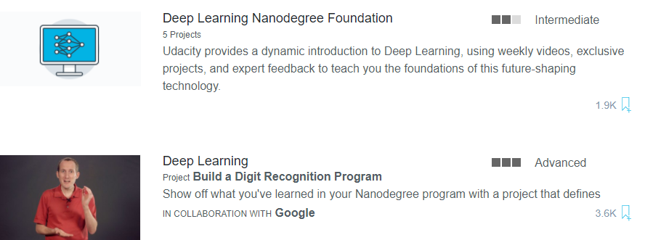

Moocs資源-1
Deep Learning Nanodegree Foundation
Deep Learning by Google

Slide 14
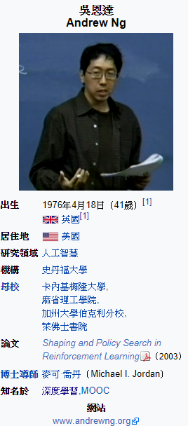
Moocs資源-2
Deep Learning Specialization-deeplearning.ai (Coursera)
Neural Networks and Deep Learning
Improving Deep Neural Networks: Hyperparameter tuning, Regularization and Optimization
Structuring Machine Learning Projects
Convolutional Neural Networks
Sequence Models

Slide 15
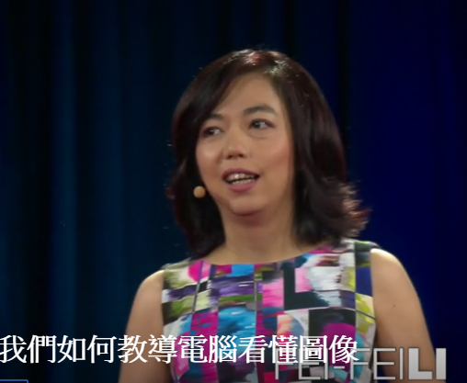
Moocs資源-3
CS231n: Convolutional Neural Networks for Visual Recognition(Spring 2017)
https://www.youtube.com/watch?v=vT1JzLTH4G4&list=PLC1qU-LWwrF64f4QKQT-Vg5Wr4qEE1Zxk
李飛飛(Fei-Fei Li)
https://www.youtube.com/watch?v=40riCqvRoMs&t=161s

Slide 16
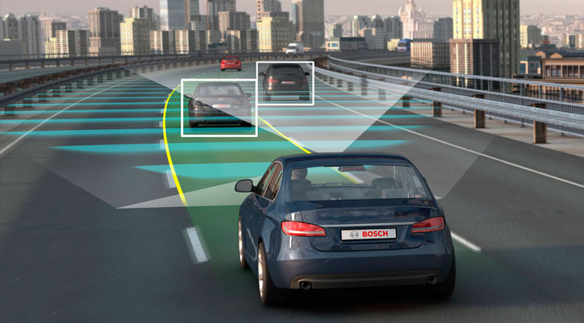
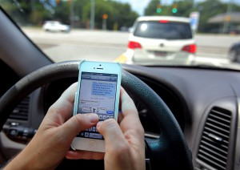
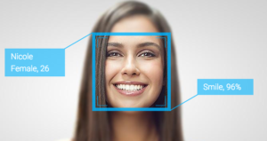
我的研究工作

Slide 17
Emotion detection
陪伴機器人(對話、Chatbot)
辨識情緒(表情、聲音)
How do we to get a lot voice dataset?

Slide 18
YouTube
人工/自動
步驟：
人臉偵測
情緒辨識
擷取人臉情緒的時間區間
擷取相對應的完整單句話之語言

Slide 19
Tech of Self driver car (1/3)
Computer Vision and Deep Learning
Sensor Fusion, Localization, and Control
Path Planning, Concentrations, and Systems

Slide 20
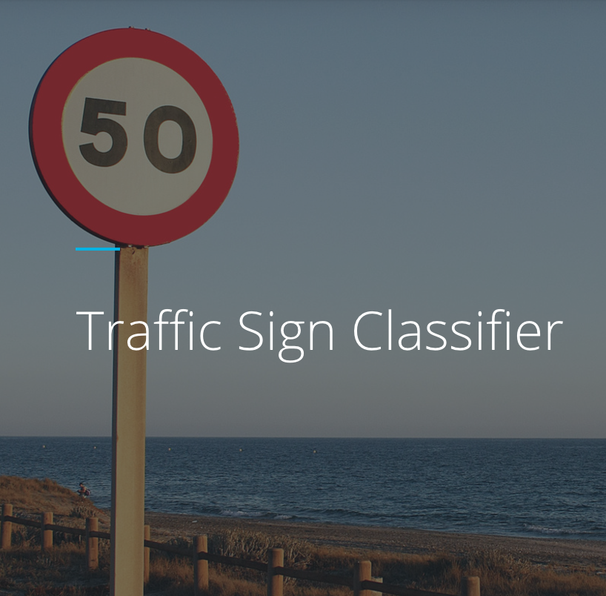
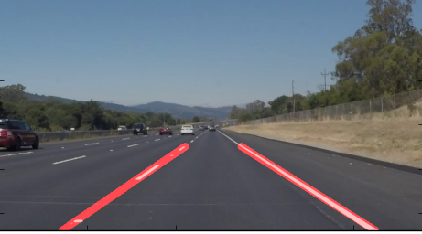
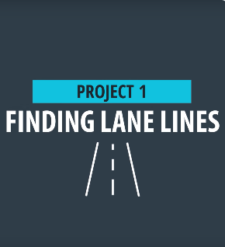
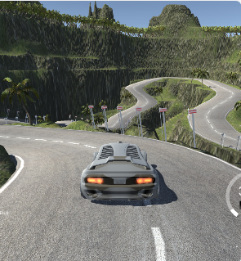
Tech of Self driver car (2/3)
Cloning human behavior
Traffic sign classifier
Lane Line detection

Slide 21
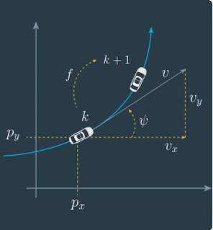
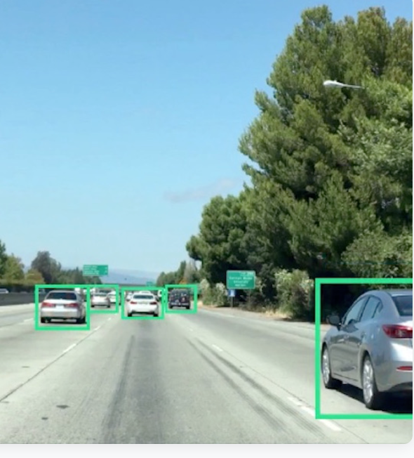
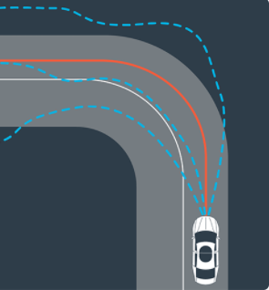
Tech of Self driver car (3/3)
Model predictive control
Track calculate
vehicle detection

Slide 22
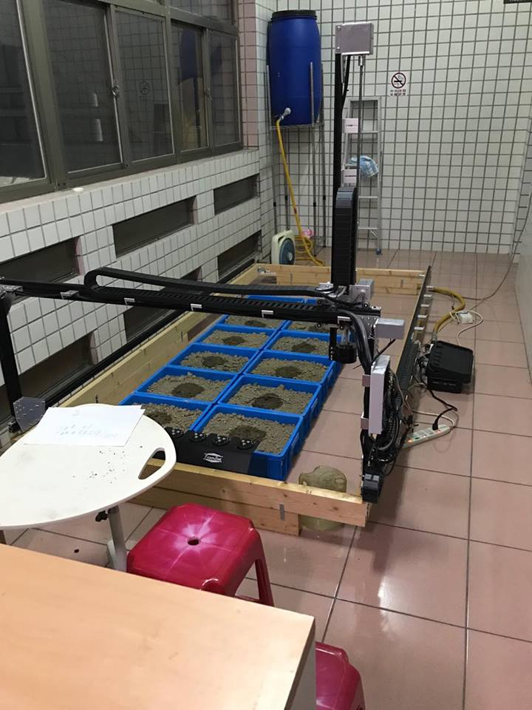

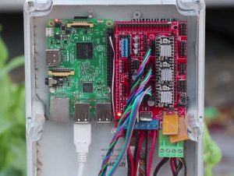
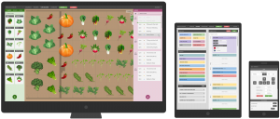
My Farmbot

Slide 23
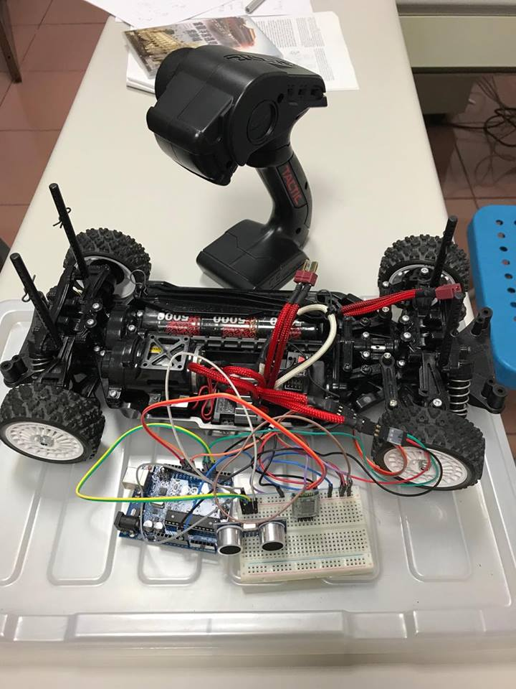
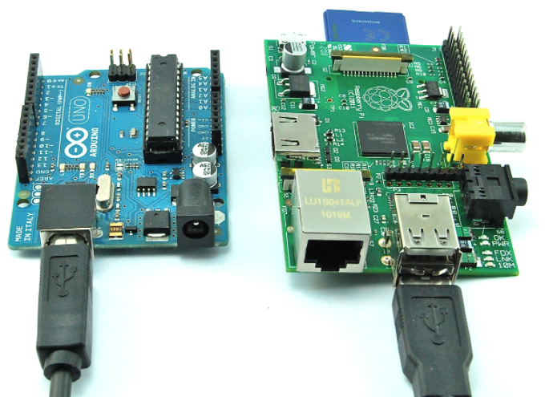
My remote control car

Slide 24


Slide 25
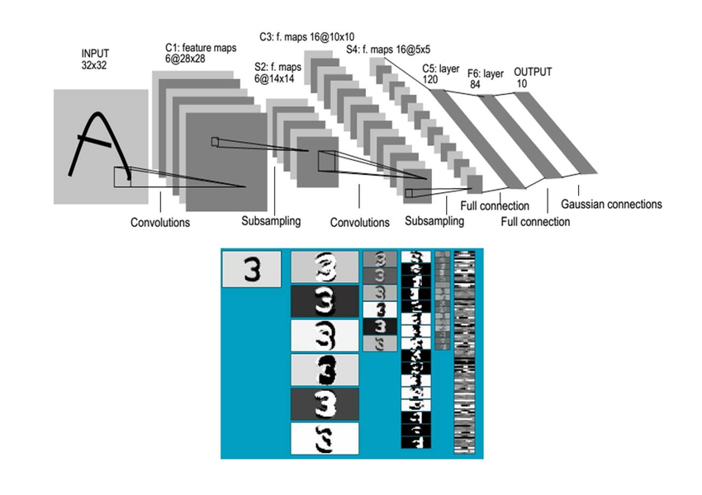
Deep Learning

Slide 26
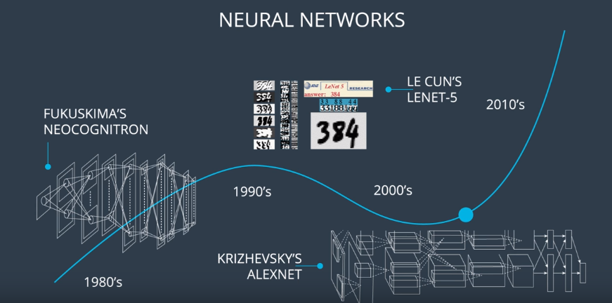
History of Neural Networks
https://classroom.udacity.com/courses/ud730

Slide 27
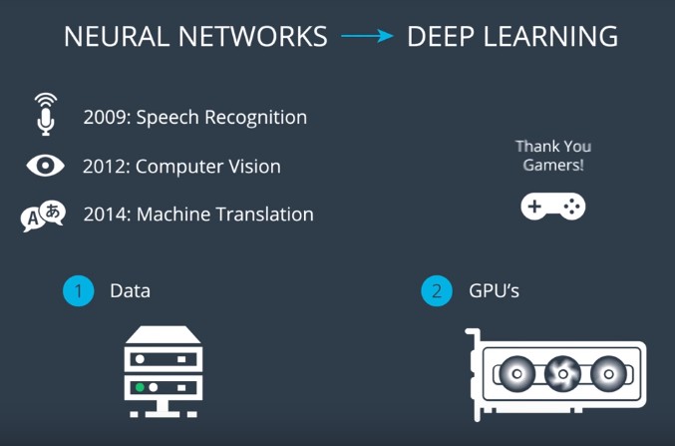
Deep Learning

Slide 28
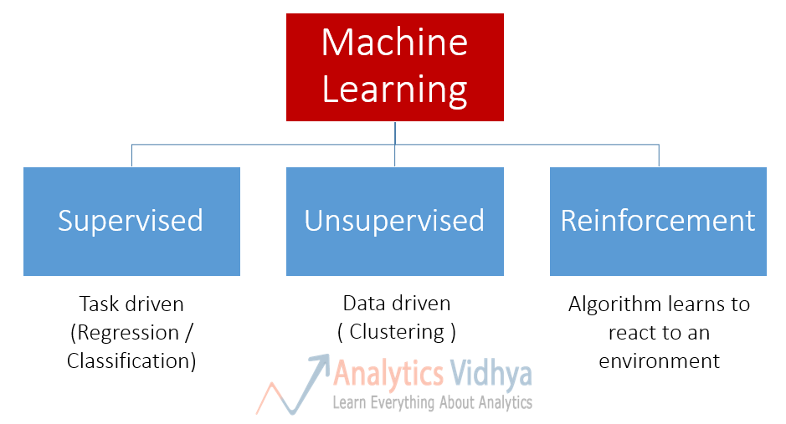
Types of Machine Learning

Slide 29
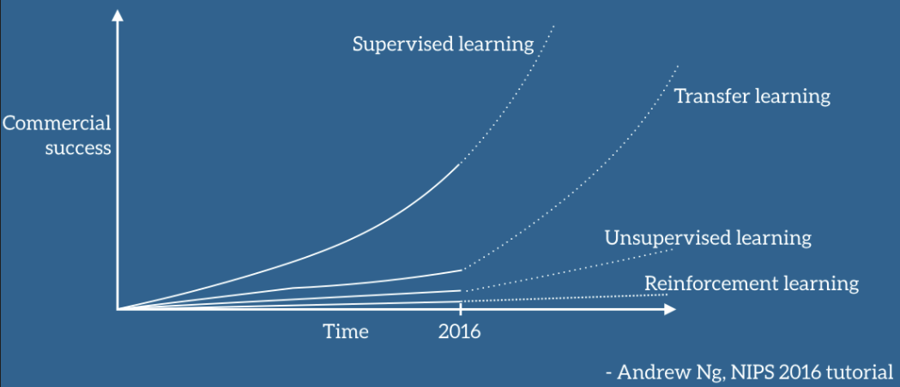
Commercial sucess

Slide 30
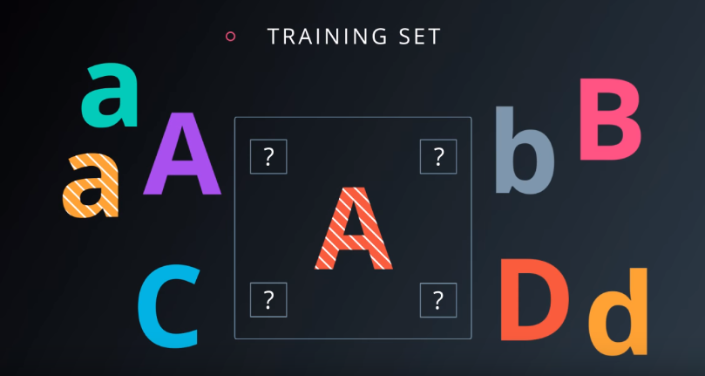
Supervised Classification(1/2)

Slide 31
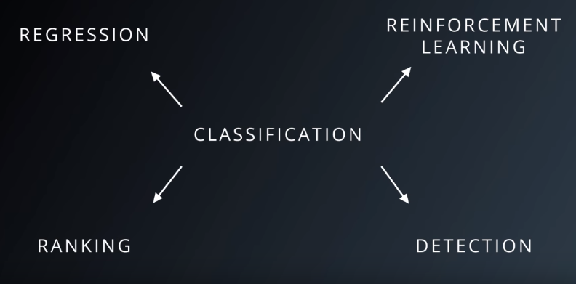
Supervised Classification(2/2)

Slide 32
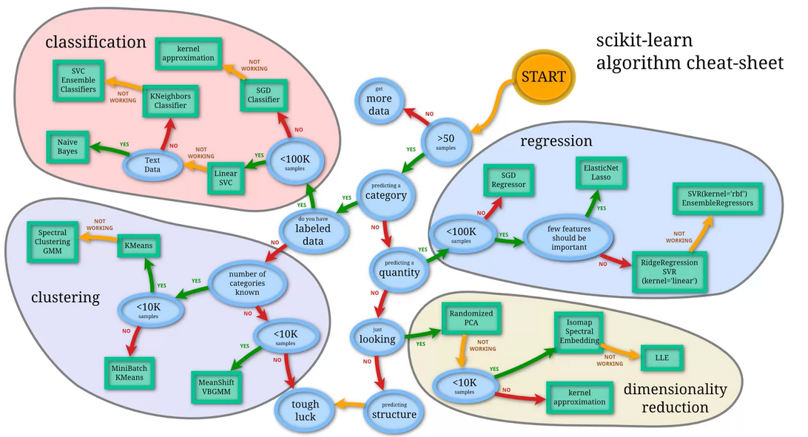
Relative Algorithms

Slide 33
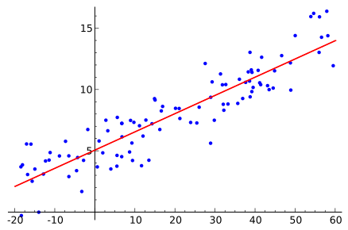
Logistic regression
In statistics, logistic regression, or logit regression, or logit model is a regression model where the dependent variable (DV) is categorical.
The case of a binary dependent variable—that is, where it can take only two values, "0" and "1", which represent outcomes such as pass/fail, win/lose, alive/dead or healthy/sick.
https://en.wikipedia.org/wiki/Logistic_regression

Slide 34
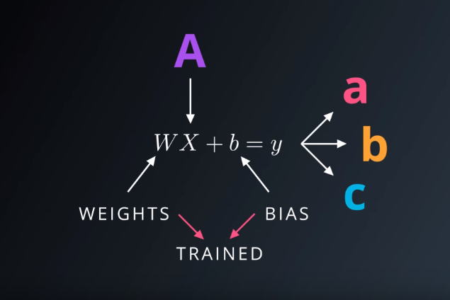
Training Your Logistic Classifier (1/3)

Slide 35
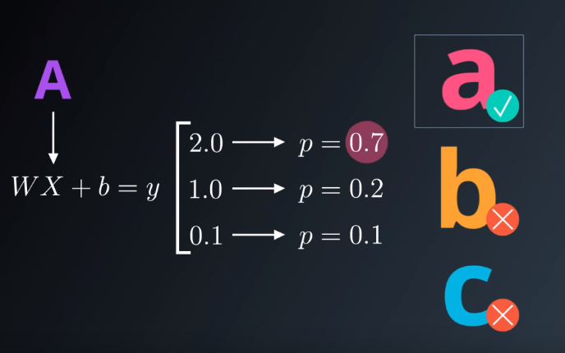
Training Your Logistic Classifier (2/3)

Slide 36
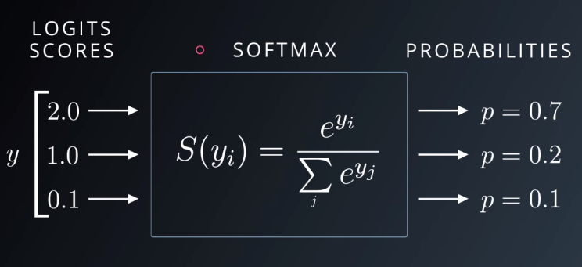
Training Your Logistic Classifier (3/3)

Slide 37
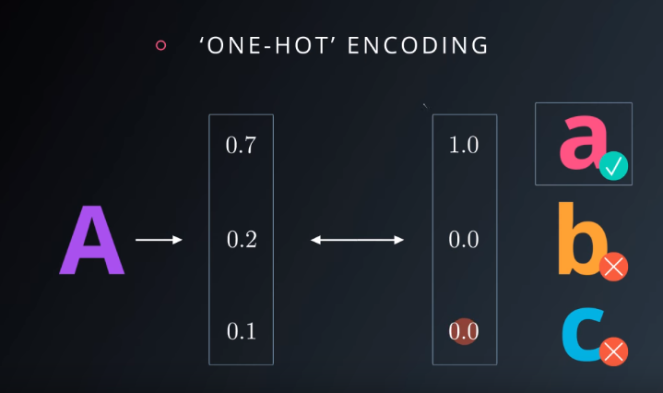
One-Hot Encoding

Slide 38
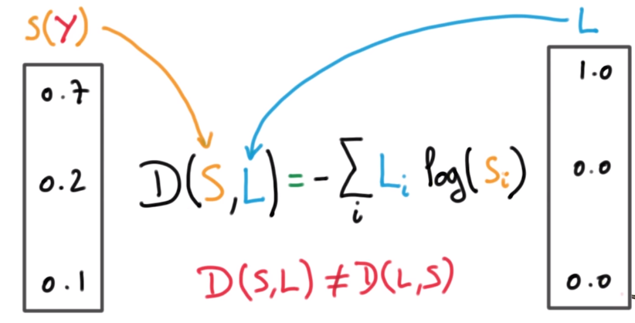
Cross Entropy(1/2)

Slide 39
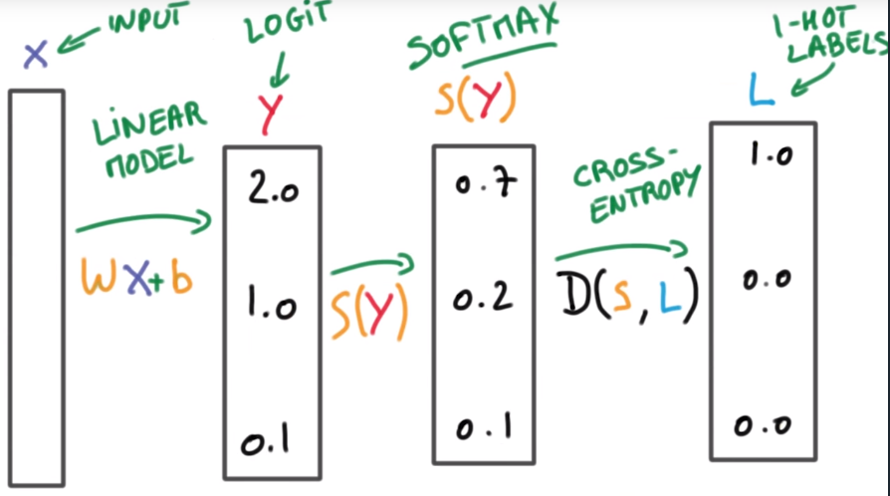
Cross Entropy(2/2)

Slide 40
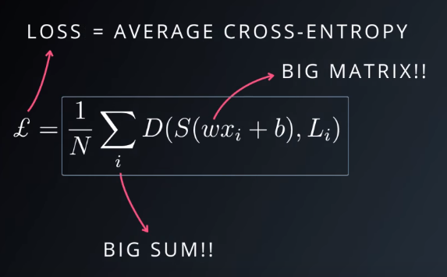
Minimizing Cross-Entropy(1/3)

Slide 41
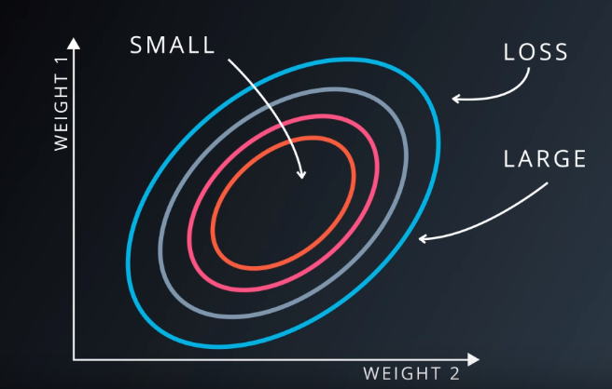
Minimizing Cross-Entropy(2/3)

Slide 42
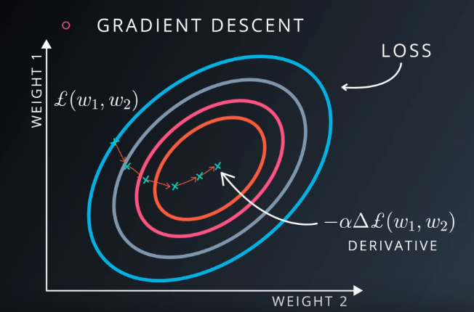
Minimizing Cross-Entropy(3/3)

Slide 43

Gradient descent (1/2)
We want the network's prediction error to be as small as possible.
Our goal is to find weights w_ij ​​​ that minimize the squared error E.
To do this with a neural network, typically you'd use gradient descent.

Slide 44

Neural Network

Slide 45
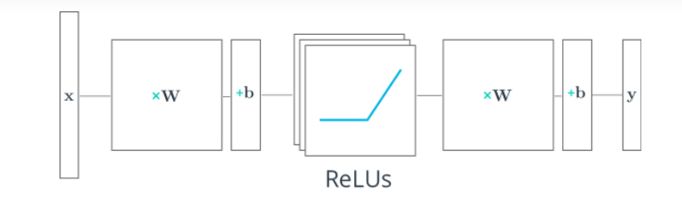
Two-Layer Neural Network

Slide 46
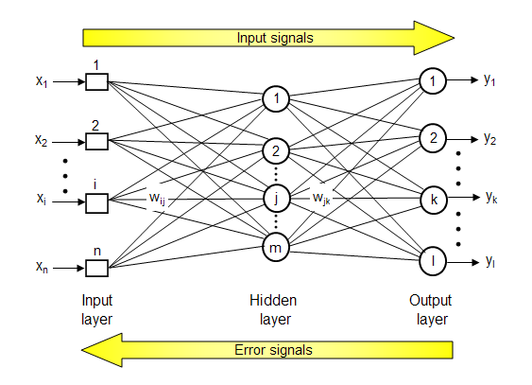
Feed forward/Backpropagation Neural Network

Slide 47
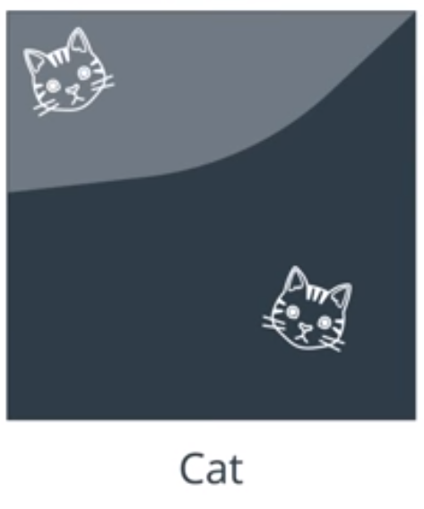
Kitten in left/right corner

Slide 48
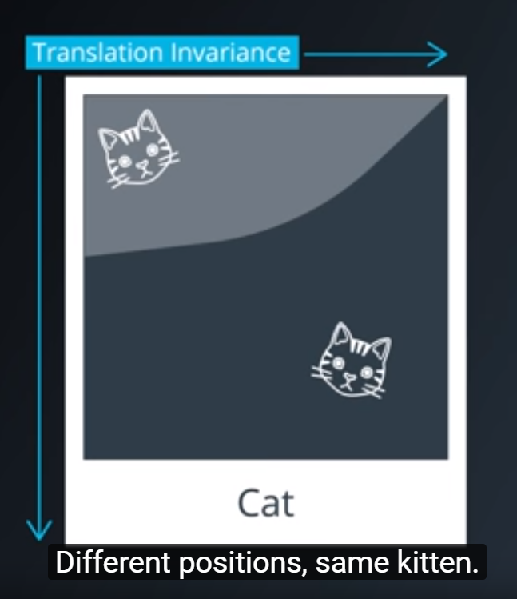

Slide 49
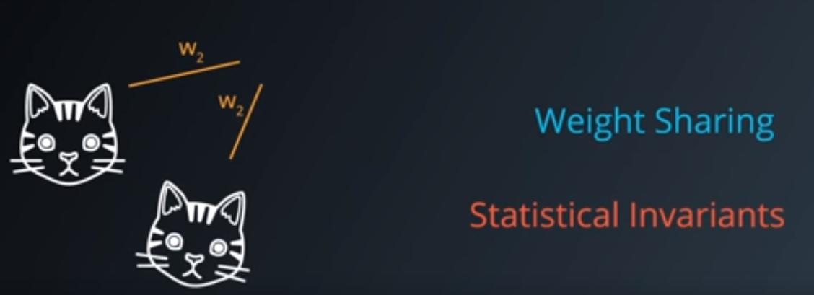
Statistical Invariants

Slide 50
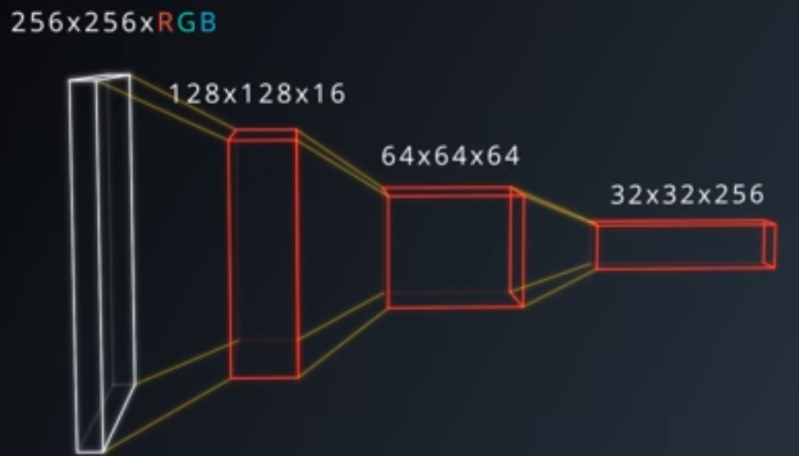
Convolution
Covnets – Neural Networks that share their parameters across space.
https://www.youtube.com/watch?time_continue=63&v=ISHGyvsT0QY

Slide 51

To classify the following image of a dog as a Golden Retriever

Slide 52
As humans, how do we do this?
One thing we do is that we identify certain parts of the dog, such as the nose, the eyes, and the fur.
We essentially break up the image into smaller pieces, recognize the smaller pieces, and then combine those pieces to get an idea of the overall dog.

Slide 53

Parts of Golden Retriever
In this case, we might break down the image into a combination of the following:
A nose
Two eyes
Golden fur

Slide 54

Going One Step Further
How do we determine what exactly a nose is?

Slide 55
CNN (1/2)
Broadly speaking, this is what a CNN learns to do.
It learns to recognize basic lines and curves, then shapes and blobs, and then increasingly complex objects within the image.
Finally, the CNN classifies the image by combining the larger, more complex objects.
In our case, the levels in the hierarchy are:
Simple shapes, like ovals and dark circles
Complex objects (combinations of simple shapes), like eyes, nose, and fur
The dog as a whole (a combination of complex objects)

Slide 56
CNN (2/2)
With deep learning, we don't actually program the CNN to recognize these specific features. Rather, the CNN learns on its own to recognize such objects through forward propagation and backpropagation!
It's amazing how well a CNN can learn to classify images, even though we never program the CNN with information about specific features to look for.

Slide 57


Slide 58

Convolutions

Slide 59

CNN uses filters to split an image into smaller patches

Slide 60
Filter Depth
It's common to have more than one filter.
Different filters pick up different qualities of a patch. For example, one filter might look for a particular color, while another might look for a kind of object of a specific shape.
The amount of filters in a convolutional layer is called the filter depth.

Slide 61

Neurons

Slide 62

Patch connect Neurons
How many neurons does each patch connect to?
Choosing a filter depth of k connects each patch to k neurons in next layer.

Slide 63

Padding

Slide 64

Fully/Locally Connected NN
參數量大幅減低

Slide 65

Max pooling

Slide 66

Convolutional pyarmid

Slide 67

Quiz
https://www.youtube.com/watch?time_continue=27&v=lp1NrLZnCUM

Slide 68

Ans. of Quiz

Slide 69

Visualizing CNNs
Zeiler and Fergus’ paper: http://www.matthewzeiler.com/wp-content/uploads/2017/07/eccv2014.pdf

Slide 70


Layer 1

Slide 71

Layer 2

Slide 72

Layer 3
The CNN learns to do this on its own.
There is no special instruction for the CNN to focus on more complex objects in deeper layers. That's just how it normally works out when you feed training data into a CNN.

Slide 73

Layer 5
The gray grid on the left represents how this layer of the CNN activates (or “what is sees”) based on the corresponding images from the grid on the right.

Slide 74
Autoencoder

Slide 75

Scale down dimensions
PCA
Autoencoders(自編碼器)

Slide 76


Slide 77

A Simple Autoencoder (1/4)

Slide 78

Application of autoencoders
We can create the noisy images ourselves by adding Gaussian noise to the training images, then clipping the values to be between 0 and 1.
We'll use noisy images as input and the original, clean images as targets. Here's an example of the noisy images I generated and the denoised images.

Slide 79

Generative Adversarial Denoising Autoencoder for Face Completion

Slide 80

Transfer Learning (1/3)

Slide 81

Transfer Learning (2/3)

Slide 82
Transfer Learning (3/3)
直接使用預訓練過的模型，這種模型已經通過大量容易獲得的數據集進行過訓練（雖然是針對完全不同的任務進行訓練的，但輸入的內容完全相同，只不過輸出的結果不同）。
從中找出輸出結果可重用的層。使用這些層的輸出結果充當輸入，進而訓練出一個所需參數的數量更少，規模也更小的網絡。
這個小規模網絡只需要了解特定問題的內部關係，同時已經通過預培訓模型學習過數據中蘊含的模式。
通過這種方式，即可將經過訓練檢測貓咪的模型重新用於再現梵谷的畫作。
原文網址：https://read01.com/QPjEzR.html

Slide 83

Google Object Detection

Slide 84

Using pre-trained Model

Slide 85

Style transfer

Slide 86
Texting while driving

Slide 87


Slide 88







Texting – Driver or Passenger

Slide 89
Pattern of T&D (1/4)
何時車輛速度降低
何時準備要講電話(傳簡訊)
何時把手機直立

Slide 90
Pattern of T&D (2/4)
Pattern 1: 開始觸發touch stroke前的平均車速、和開始觸發touch stroke後的平均車速。
Pattern 2: 在每一個touch stroke發生時(後)，產生的車輛偏移改變。
Pattern 3: 在touch stroke發生時，手機被直立放置。(有些case手機水平放置)

Slide 91
Pattern of T&D (3/4)
單手作還是雙手操作手機。
很多少單手操作手機時(拇指按鍵盤)，具有相同的pattern.
拇指按空白鍵時x-axis震動比較大。(輸入法不同會比較少用到space bar)
剎車使用頻率增加而且比較激烈。正常駕駛會用油門收放，達成更平順的速度控制，用手機時，因分散專注力，常會造成較緊急狀況才急踩剎車，故剎車使用頻率增加。

Slide 92
Pattern of T&D (4/4)
 | Speed | Turn | Texting | Driving | 備註
Camera |  |  |  | v
Accelerometer |  |  | v |  | Texting時加速度變負，轉彎時停止Texting
Gyro |  | v | v(Gyro-x) |  | 週期性的震動
Orientation |  |  | v |  | 水平或接近垂直
GPS | v |  |  | v | Texting時速度變慢，轉彎時停止Texting

Slide 93

Pattern of texting while driving

Slide 94



Texting Detectors based on Gyro Sensor
…

Slide 95
Transfer Learning for WiFi-based indoor localization

Slide 96

WiFi fingerprint-based indoor localization (1/2)

Slide 97

WiFi fingerprint-based indoor localization (1/2)

Slide 98


Slide 99

Different time period and device

Slide 100


Slide 101
Summary
MS Excel – Regression
Computational intelligence
Data scientist
Programming by means of framework

